Slide 1
Tutorial 9 - Dijkstra Algorithm
Calculate the shortest path from vertex A to other vertices.

Slide 2
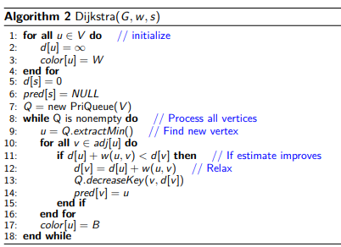
Example 1
60
A
30
B
20
C
15
D
10
15
3
16
6
3
6
E
7
F
8
G
10
H

Slide 3
Example 2
A
12
32
8
B
16
C
29
21
15
27
13
D
7
E
19

